Slide 1
Indian Institute of Technology (ISM) , Dhanbad
FINAL YEAR B.TECH PROJECT
Absorption Spectra of Quantum Dots
ASHISH RANJAN
SOURAV KUMAR MANDAL
SUPERVISOR: PROF. SUBINDU KUMAR

Slide 2
Recently much attention has been focused on zero-dimensional electron hole systems realizable by fabricating quantum dots froma semiconductor multiple quantum well layer structure.
Quantum dots (QDs) are semiconductor nanoparticles that are usually between 1.5 and 10 nanometers in size. QDs have unique optical and electronic properties that depend on their size and composition. The size of a QD determines the wavelength of light it emits, and therefore the color it emits.Quantum dots which exist at nanometre scale has tunable optical and electrical properties due to their size at the nanometer scale and due to quantum confinement effects in these small structures..They are expected to replace traditional infrared photodetectors in a wider range of applications and are already used in optical communication, imaging, and biological monitoring.
Quantum Dots

Slide 3
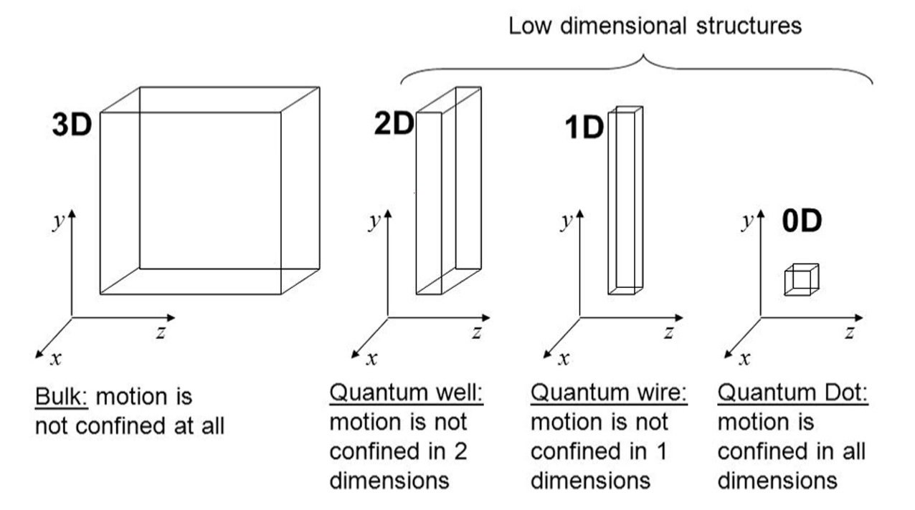

Slide 4
The absorption spectrum of zero-dimensional carrier gas is expected to be a series of delta-function like discrete lines because of its absence of the density of states.But In many cases the spectra do not show the characteristic structure of a series of isolated absorption peaks as expected from a zero-dimensional electron-hole gas. This is mainly due to the broad distribution of quantum dot sizes or cluster sizes.Since the electronic energy levels in quantum dots are strongly dependent on their sizes, the shape of the absorption lines will be critically dependent on the degree of their size nonuniformity
Absorption spectrum of Quantum Dots

Slide 5
In an infinite quantum well model, the energy levels of the confined particles (electrons or holes) are quantized and evenly spaced due to the assumption of an infinitely deep potential well.The wave functions of the confined particles are sinusoidal within the well and decay exponentially outside the well.Quantum Dots Generated from Infinite Quantum Well have infinite conduction band and infinite valence band height.The dots were approximated as cubic boxes having infinite potentials at the boundaries.Quantum dots generated from infinite quantum wells are often used in applications where precise control over the energy levels and strong confinement are crucial, such as in quantum computing, single-photon sources, and certain optoelectronic devices.
Quantum Dots Generated From Infinite Quantum Wells

Slide 6
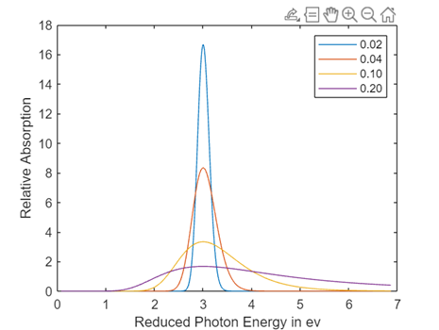
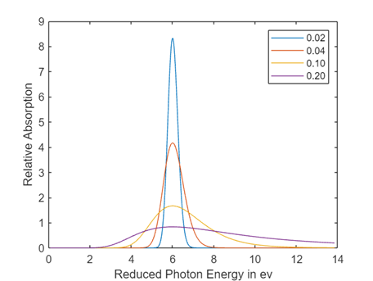
Plots Of Quantum Dots generated From Infinite Quantum Well
Above Figure (Fig 1 for n^2=3 lowest state,Fig 2 for n^2=6 First Excited state) shows that for a given transition, peak value decreases and linewidth increases rapidly as or degree of non-uniformity increases.

Slide 7
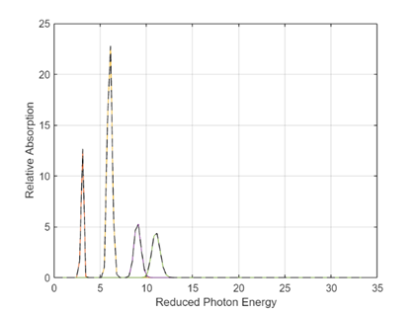
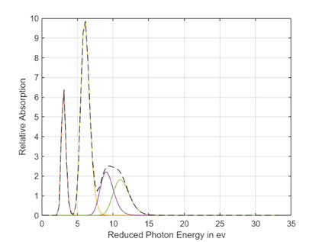
Plots Of Quantum Dots generated From Infinite Quantum Well
Figure 3 (zeta=0.02)
Figure 4 (zeta=0.05)

Slide 8
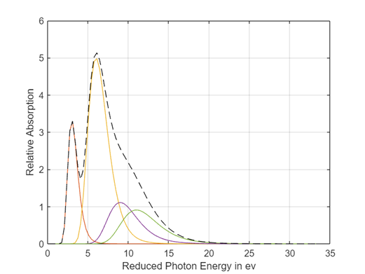
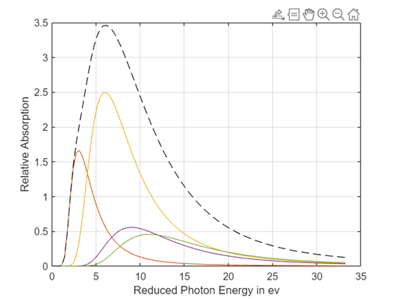
Plots Of Quantum Dots generated From Infinite Quantum Well
Figure 5 (zeta=0.1)
Figure 6 (zeta=0.2)

Slide 9
In a finite quantum well, the potential well has a finite depth, which leads to non-uniform spacing between the energy levels and the possibility of bound states outside the well.The wave functions exhibit more complex behavior, with penetration into the barrier regions and oscillations outside the well.Finite quantum well is just a simplified way of representing our complex problems. It has well defined boundaries, so its easier to solve mathematically. But in a realistic case nothing can have infinite potential.
Finite potential well takes the more realistic situation of having a limited potential wall rather than having an infinite potential wall.
Quantum Dots Generated From finite Quantum Wells

Slide 10
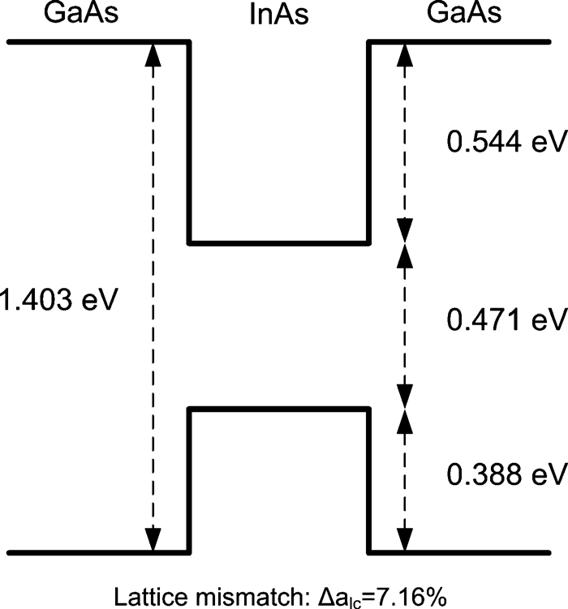
ENERGY BAND DIAGRAM OF FINITE QUANTUM WELL
The figure shows a finite well size of a InAs-GaAs Quantum dot system. This doesn’t have an infinite barrier compared to a hypothetical situation.

Slide 11
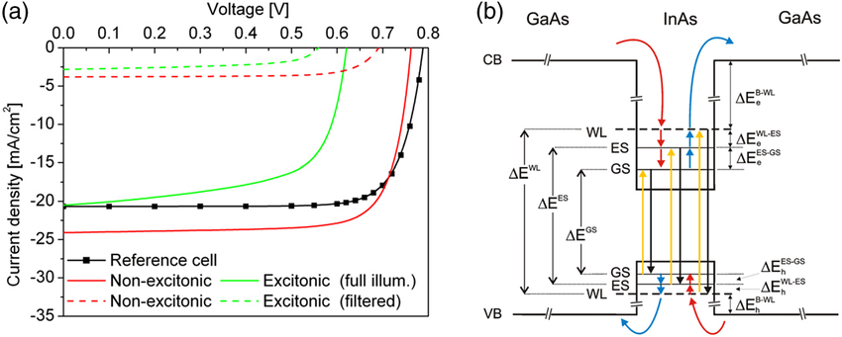
Transitions in Finite Quantum Well
A photon with energy less than the band gap of InAs cannot excite an electron from valence band to the conduction band.As there is a finite barrier, transitions above transitions are not probable.
There are only limited no of bands where transitions can occur.
The figure shows a finite well size of a InAs-GaAs Quantum dot system. The yellow lines show different possible transitions.

Slide 12
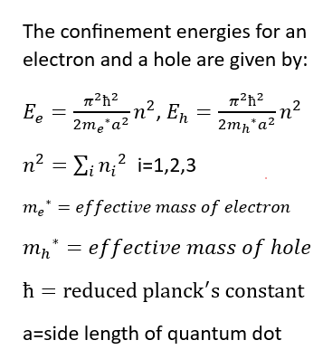
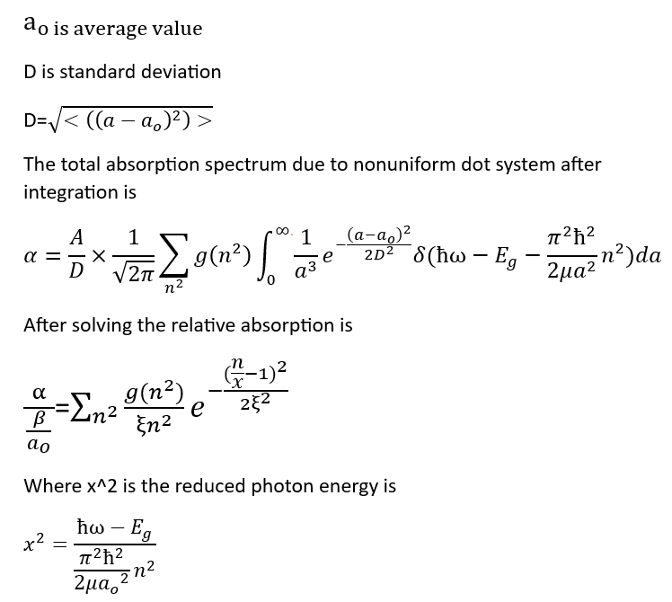
FORMULAS OR EXPRESSIONS USED DURING PLOTTING OF ABSORPTION SPECTRA AND LINEWIDTHS

Slide 13
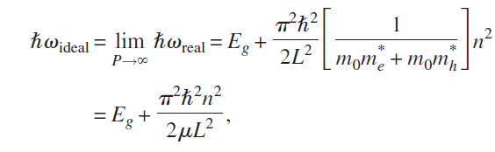
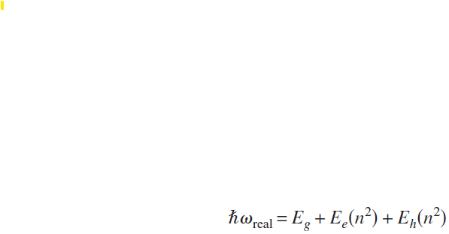
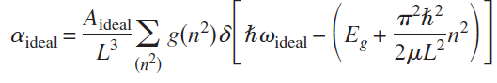
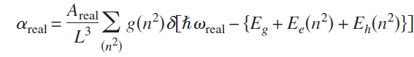
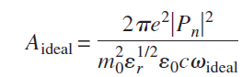
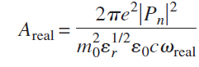
FORMULAS OR EXPRESSIONS USED DURING PLOTTING OF ABSORPTION SPECTRA AND LINEWIDTHS
IDEAL
REAL
Optical absorption coefficient:-
Optical absorption coefficient:-

Slide 14
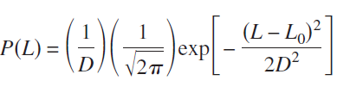
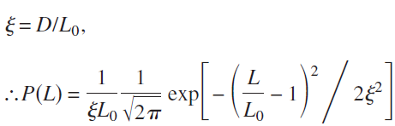
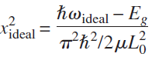
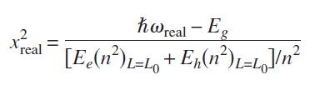
DEFINING TERMS
Gaussian distribution
Relative std. deviation of dot size which is ratio of standard deviation of dotsize to average dot size
New Equation for Gaussian distribution
Reduced Photon Energy

Slide 15
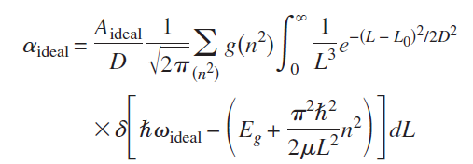
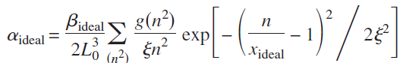
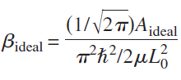
IDEAL

Slide 16
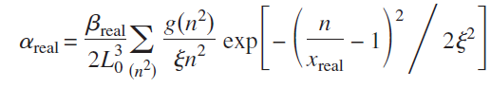
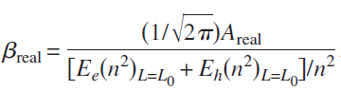
REAL

Slide 17
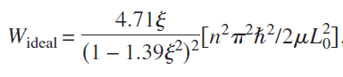
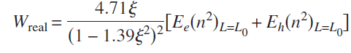
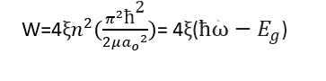
IDEAL
REAL
Line width
Line width

Slide 18
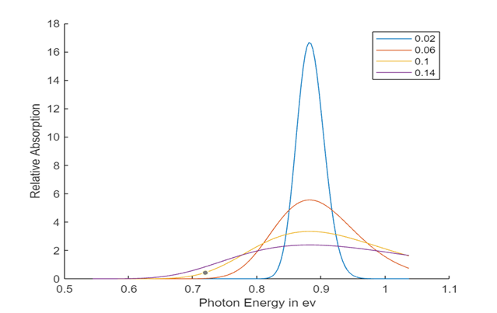
Plots Of Quantum Dots generated From finite Quantum Well of InAs

Slide 19
Quantum Dot with varying In and GaAs composition in InGaAs Quantum Dot System
In the InGaAs quantum dot (QD) system, the mole fraction of indium (In) and gallium (Ga) is varied to change the properties of the QDs like :-
Bandgap:- The bandgap of a semiconductor is the energy difference between its valence and conduction bands. InGaAs is a direct bandgap material, meaning the minimum energy transition occurs between states with the same momentum. The bandgap energy of the InGaAs alloy can be tuned by varying the In mole fraction. Increasing the In mole fraction reduces the bandgap energy of the InGaAs alloy, allowing for emission at longer wavelengths .The bandgap of the QDs determines the emission wavelength, which is crucial for optoelectronic and photonic applications. As the In mole fraction (x) increases, the bandgap becomes smaller (redshifts) due to the weaker bond strength between In and As compared to Ga and As.

Slide 20
Quantum Confinement:- InGaAs quantum dots are nanoscale semiconductor structures where electrons and holes (charge carriers) are confined in all three spatial dimensions.This confinement quantizes the energy levels available to the carriers, similar to an atom.The size and shape of the quantum dot, along with the In composition (x), determine the energy levels and the wavelength of light emitted or absorbed.A higher In content leads to a deeper confinement potential, resulting in stronger quantum confinement effects.
InGaAs quantum dots with specific In compositions are important for various optoelectronic applications due to their tunable bandgap and ability to confine electrons and holes within the quantum dot region.
These applications include:-
·Infrared Detectors: InGaAs with higher In compositions (around 0.66) can be used for infrared (IR) detection due to its long-wavelength light absorption capability.It has potential applications in various optoelectronic devices due to its tunable bandgap and ability to manipulate light-matter interaction at the nanoscale.

Slide 21
Here we have taken Indium in 0.66 mole fraction and Gallium in 0.33 mole fraction
for calculation purpose.
The band gap(Eg) of In Ga As is determined from the empirical relation
Eg(InGaAs) = 1.516 − 1.214*x + 0.264*x*x.
where x is the concentration of indium.
The effective masses were taken to be 0.041m0 for electrons and 0.417m0 for holes
which were obtained through a linear extrapolation between the effective masses of
InAs and GaAs.
Eg(InGaAs) considered to be 0.830 eV.
The band offset ratio were considered to be 60:40, respectively.
For realistic dots, the well heights of the conduction and valance bands were
found to be 0.412 and 0.274 eV, respectively.
The average dot size was considered to be 9 nm.
x
1-x

Slide 22
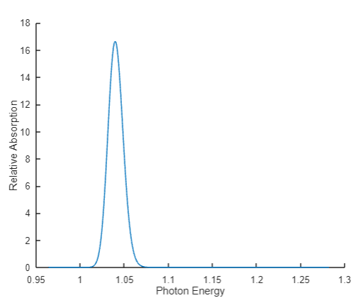
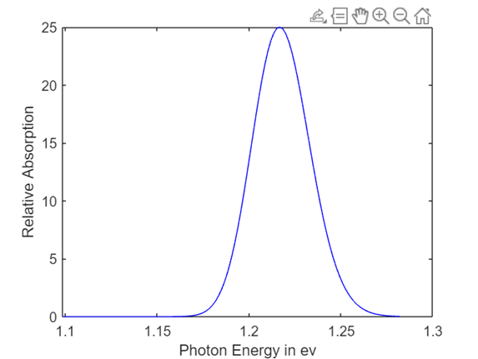
Plots Of Quantum Dots generated From finite Quantum Well of In0.66Ga33As
n^2=3,zeta=0.02
n^2=6,zeta=0.02

Slide 23
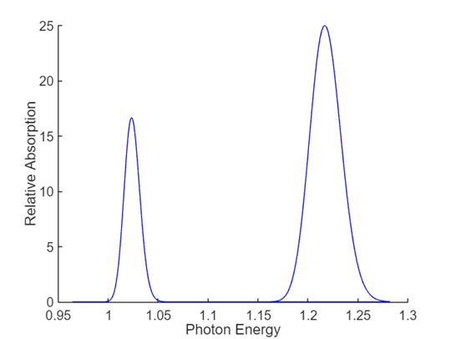
Plots Of Quantum Dots generated From finite Quantum Well of In0.66Ga33As
Superposition plots for (For zeta=0.02)

Slide 24
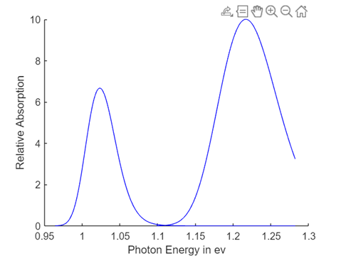
Plots Of Quantum Dots generated From finite Quantum Well of In0.66Ga33As
Superposition plots for (For zeta=0.05)

Slide 25
Line Width
Linewidth of n^2th absorption peak which is defined as e^(-0.5) of the maximum absorption.
This definition of linewidth is commonly used because it provides a consistent way to quantify the width of absorption peaks, regardless of their specific line shape (Gaussian, Lorentzian, or a combination). It is particularly useful when the peak shape is not perfectly described by a simple analytical function, as it allows for a direct comparison of linewidths between different peaks or spectra.

Slide 26
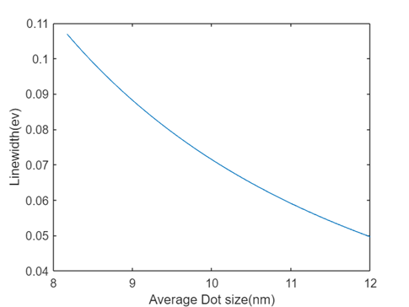
Linewidth Plots Of Quantum Dots generated From finite Quantum Well of In0.66Ga33As
(For zeta=0.02)

Slide 27
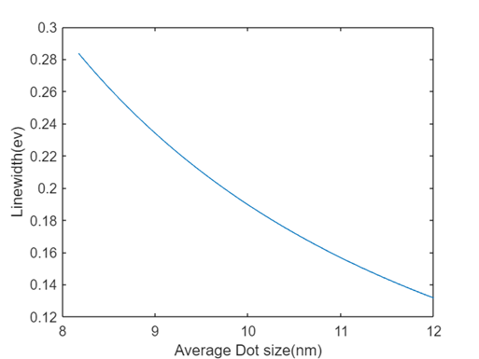
Linewidth Plots Of Quantum Dots generated From finite Quantum Well of In0.66Ga33As
(For zeta=0.05)

Slide 28
RESULTS
We can see that as ξ or degree of non-uniformity increases in quantum dot system,peak value starts decreasing and linewidth starts increasing.
As ξ or degree of non-uniformity increases, overlap between nearby peaks are expected.
In case of Quantum Dots From finite Quantum Well,relative absorption value decreases with increase in zeta and also as well height is finite so curve start to break after attaining a particular value of photon energy
As zeta increases, the resolvability decreases. It should be noted at this juncture that for the In0.66Ga0.33As/GaAs QD system the curves could not be extended beyond a certain energy (1.302 eV)since the confinement energies exceeded the height of the well and only the lowest two transitions could be observed
It is observed that for realistic dots, there is a redshift of the absorption peaks and there is a decrease in the linewidth as compared to the ideal QD system for the same size deviation.

Slide 29
Conclusions
The effect of dot size variation on the resolvability of the absorption peaks is estinated in case of Quant Dots of Infinite Quantum Well.
The effects of size nonuniformity on the optical absorption spectra of few realistic QD systems were analyzed, and the results have been compared with ideal dots having infinite potentials at the boundaries.
Variation Of Linewidth with respect to average dot size about zeta or degree of nonuniformity in dot size is also estimated

Slide 30
References
Effect of size non uniformity on absorption spectrum of a semiconductor quantum dot system, Wei-Yu Wu, J. N. Schulman, T. Y. Hsu, and Uzi Efron – 1987
Effects of a Gaussian size distribution on the absorption spectra of III-V semiconductor quantum dots, Subindu Kumar; Dipankar Biswas-2007
Semiconductor quantum dots: Technological progress and future challenges, F. Pelayo García De Arquer, Dmitri V. Talapin, I. Klimov, Yasuhiko Arakawa, Manfred Bayer, And Edward H. Sargent
H. C. Liu, M. Gao, J. McCaffrey, Z. R. Wasilewski, and S. Farad, Appl. Phys. Lett.https://doi.org/10.1063/1.1337649 78, 79 (2001).
Y. H. Kang, J. Park, U. H. Lee, and S. Hong, Appl. Phys. Lett.https://doi.org/10.1063/1.1555711 82, 1099 (2003).
J. Phillips, P. Bhattacharya, S. W. Kennerly, D. W. Beckman, and M. Dutta, IEEE J. Quantum Electron.https://doi.org/10.1109/3.766837 35, 936 (1999).
Wikipedia-Quantum Dots

Slide 31
THANK YOU

